Slide 1

Learn about SNA Membership!
www.schoolnutrition.org
Notes:
Welcome/Intros
Who here is a member? {ask for hands}
We’re going to talk about many of the benefits of SNA membership and why you should become a member of SNA if you aren’t one already.

Slide 2

Who We Are
Professional association representing over 50,000 members who work in school nutrition.
Notes:
Don't forget to introduce your district/organization, too!
"A little bit of background on SNA National for those who may be new to SNA or not yet members:
The School Nutrition Association (or SNA) is a national, non-profit professional organization representing more than 50,000 members who provide high-quality, low-cost meals to students across the country. Our members are foodservice directors, employee, managers, state agency professional, and allied organizations
SNA works to ensure all children have access to healthful school meals and nutrition education.
With 49 state affiliates, hundreds of local chapters and thousands of school nutrition members and industry partners, SNA brings a unique, firsthand perspective to child nutrition issues."

Slide 3
SNA Mission
We empower and support school
nutrition professionals in advancing the
accessibility, quality and integrity of
school nutrition programs.
Notes:
"Our mission is to be the national organization of school nutrition professionals as we empower and support school nutrition professionals in advancing the accessibility, quality and integrity of school nutrition programs."

Slide 4
Top 8 Reasons to Join SNA
SNA membership is a smart investment for you and your program.
Become a member today at www.schoolnutrition.org/join
Notes:
"There are many benefits to SNA membership, but we're just going to look at the top 6 benefits today."
Please add/include specific benefits offered by your state!!!

Slide 5


1. Empower Your Growth
Free live and on-demand webinars at your fingertips in The Training Zone.
Notes:
Professional Development - School Nutrition Association
"When you can’t make it to a live professional development event, catch up later with on-demand and self-paced training courses. Browse available courses or use the search function below to find a course by category, course type, CEUs or CPEUs."
"Scan the QR Code with your device to view the Training Zone, now!"
Add state benefits

Slide 6
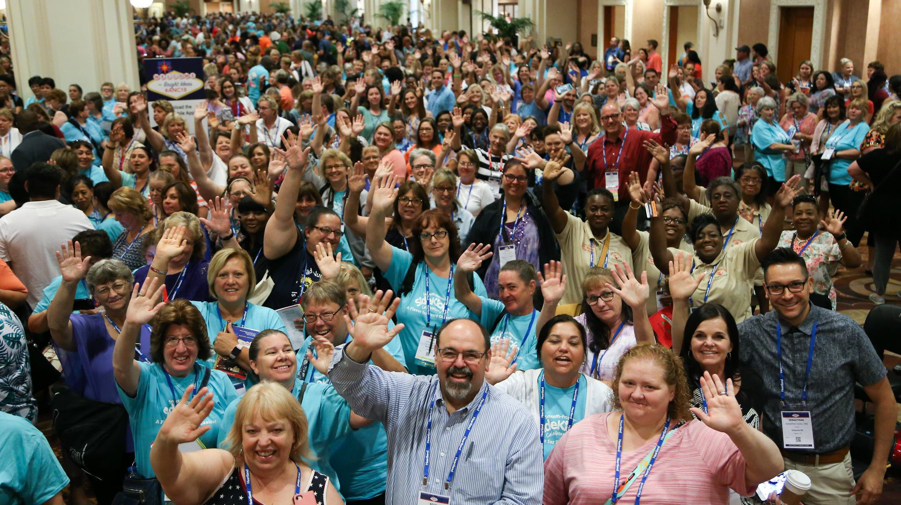
2. Expand Your Network
Unparalleled in-person & virtual networking & professional development opportunities.
Notes:
Conferences & Events - School Nutrition Association
"We have some great conferences in the year ahead that I would encourage you to mark on your calendars."
"Our School Nutrition Industry Conference will be held on January 15-17, 2023, in San Diego, California."
"The Legislative Action Conference will be held in Washington DC on March 5-7, 2023 and is a chance for you as members to advocate for school nutrition programs on Capitol Hill."
"Lastly, the school nutrition event of the year is the Annual National Conference which will be held in Denver Colorado on July 9-11, 2023.“
Plus, you can always participate in SNA’s ongoing STEPS Wellness program by downloading the SNA Strive to Thrive App.
Add state-specific meets and events!

Slide 7

3. Amplify Your Voice
Unyielding efforts to provide a voice for school nutrition at the state and national levels.
SNA’s PAC supports legislators who have shown leadership in fighting for the health of children & provides contributions in a bipartisan manner to elected representatives who support child nutrition.
Notes:
Child Nutrition Advocacy | School Nutrition Association
"SNA closely tracks federal and state legislation and regulations and advocates for school nutrition programs and professionals across the country. Priorities include:
Universal School Meals
Child Nutrition Reauthorization
Federal Register and USDA Updates
COVID-19 Relief
State Legislation and Policy"

Slide 8


4. Advance Your Career Path
The ability to grow professionally with Certificate & Credentialing programs.
Notes:
Certificate & Credentialing - School Nutrition Association
"Are you ready to grow your career and be seen as a K-12 school nutrition leader?"
"Well SNA is the place to be! By making SNA your professional organization, it will open up new opportunities and demonstrate your professionalism by earning a School Nutrition Specialist Credential or Certificate in School Nutrition."
"Whether you’re pursuing one of the four levels of the Certificate Program or sitting for the Credentialing exam, these pathways help you achieve the professional growth you deserve."
"Scan the QR code to access SNA's Certificate and Credentialing program!"

Slide 9

5. Certify Your Experience
Achieve recognition and validate your skills with our specialized certificate and credentialing programs.
Notes:
School Nutrition Magazine - School Nutrition Association
"School Nutrition magazine is the flagship publication of the Association and the go-to resource for solutions and strategies for K-12 food service professionals."
"Every issue ever published is available on SNA’s website (including a robust Recipe Library!)"

Slide 10
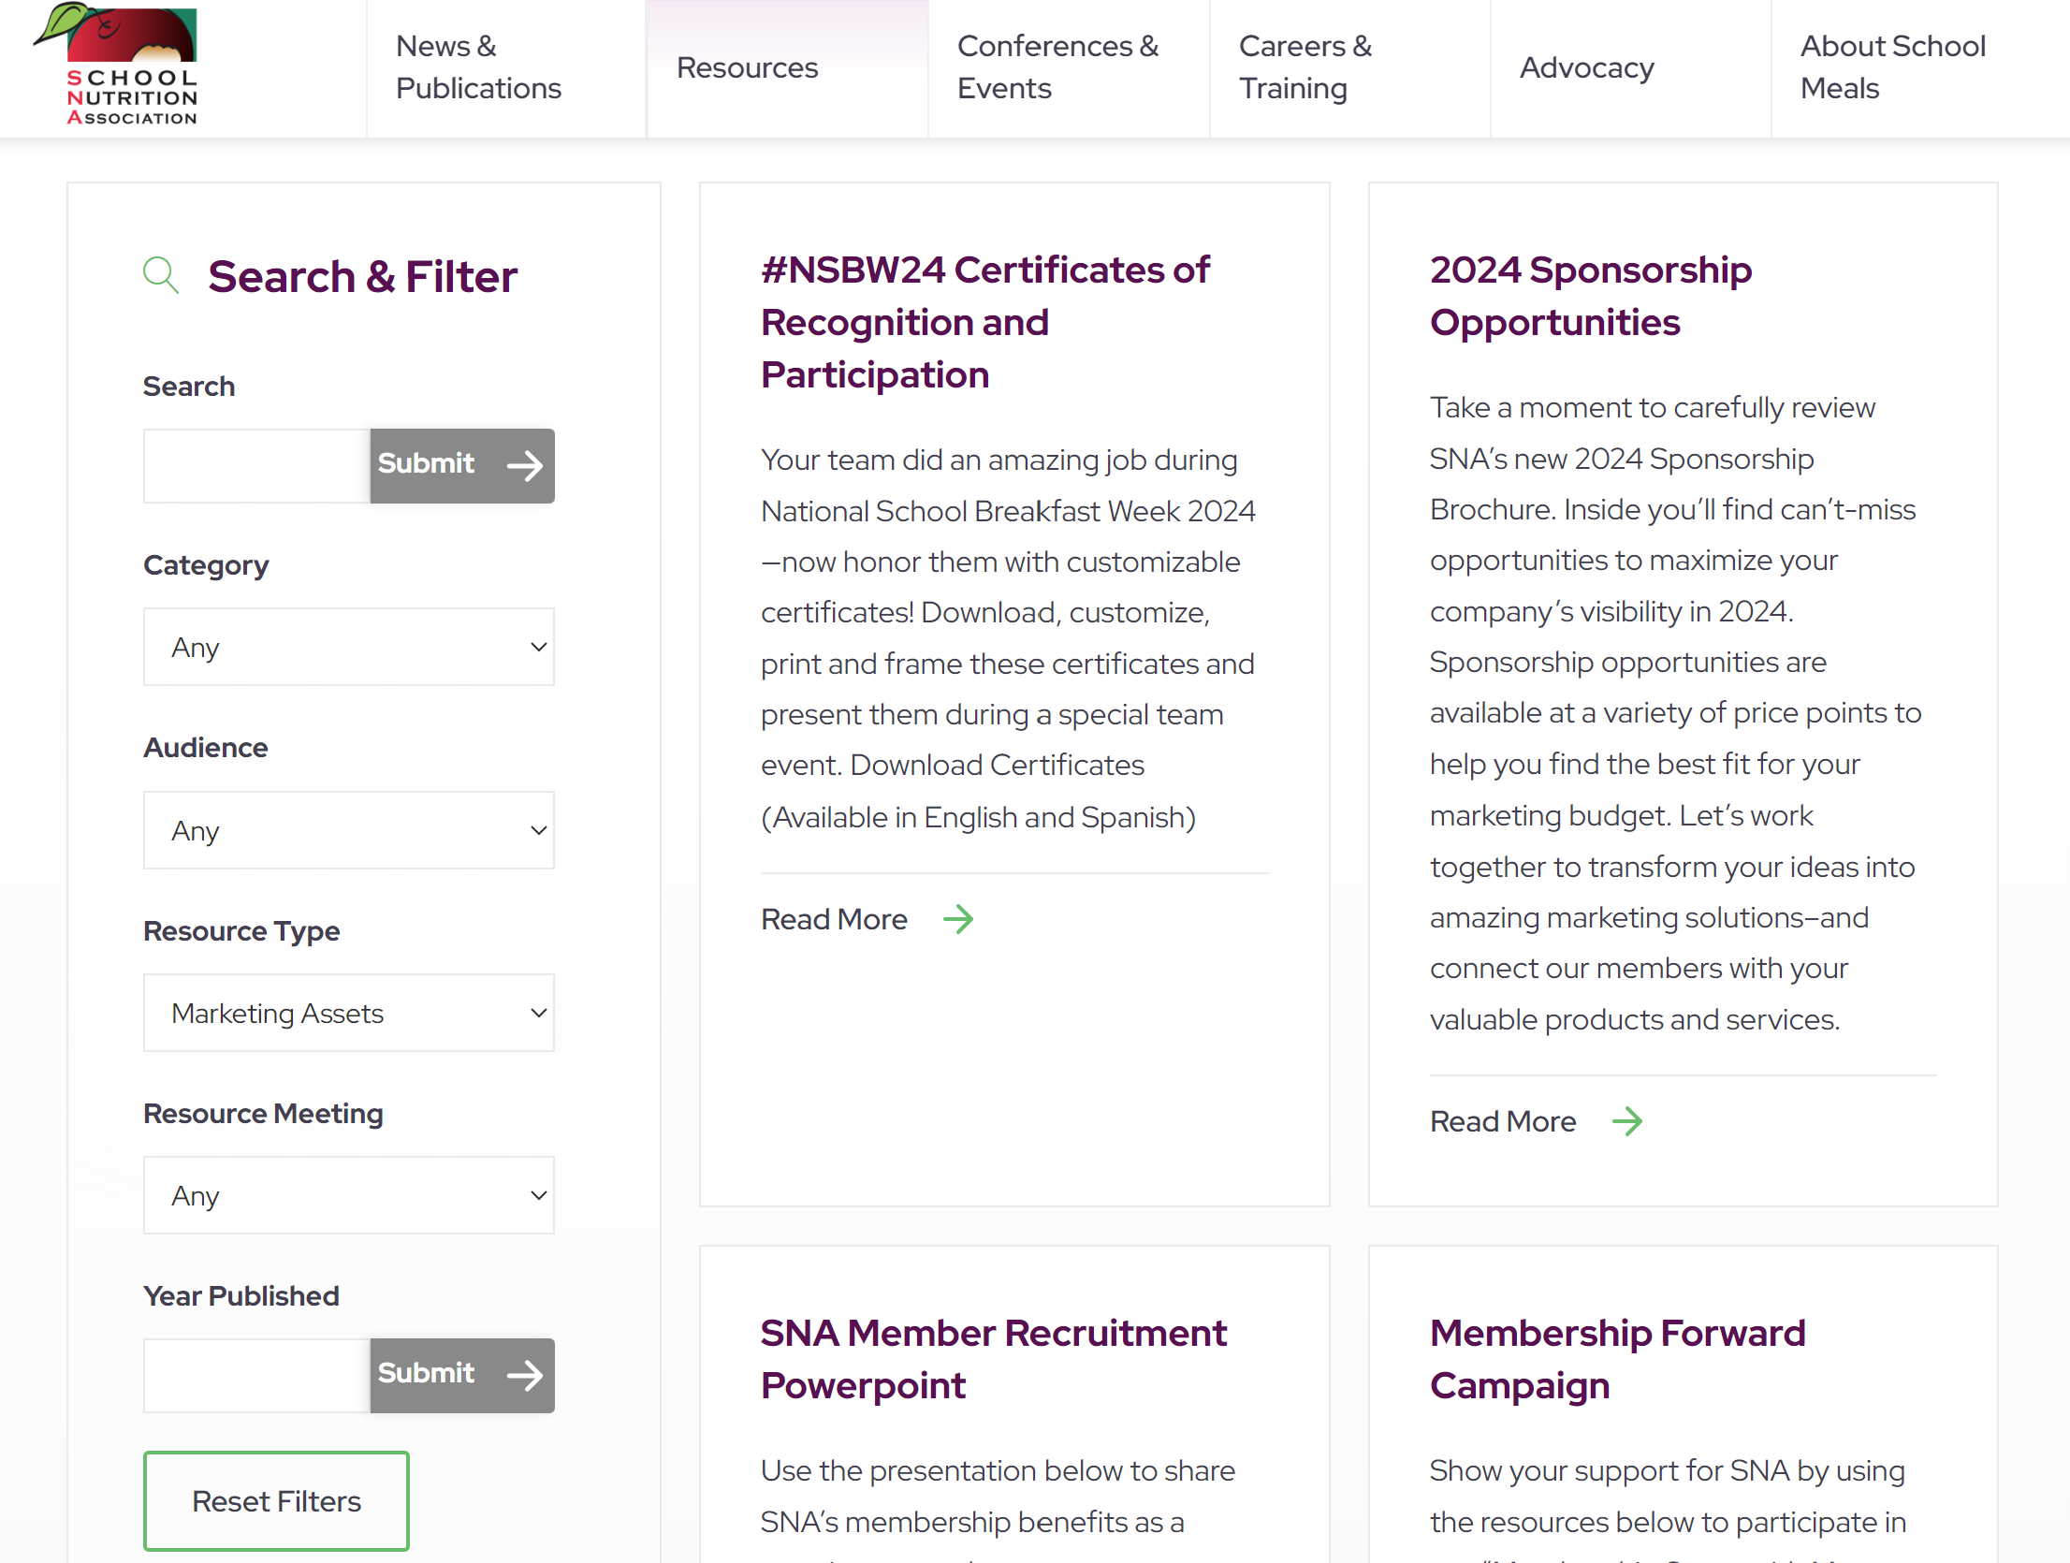
6. Promote Your Program
The SNA website houses shareable marketing and promotional materials.
To access resources: Click Resources > Resource Library > Filter ‘Resource Type’ by ‘Marketing Assets’
Notes:
Resource Library - School Nutrition Association
"You have an unwavering commitment to feeding students. SNA is here to provide the resources you need to grow your school meals program to its greatest potential. From School Lunch Hero Day to membership recruitment, the SNA website has everything you need to get involved!”

Slide 11
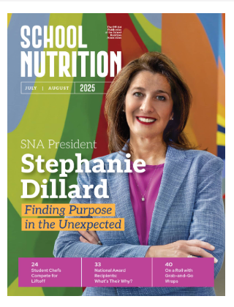
7. Keep Yourself Informed
Get the latest trends, and success stories delivered through a subscription to SNA’s Award Winner SN Magazine.
Notes:
School Nutrition Magazine - School Nutrition Association
"School Nutrition magazine is the flagship publication of the Association and the go-to resource for solutions and strategies for K-12 food service professionals."
"Every issue ever published is available on SNA’s website (including a robust Recipe Library!)"

Slide 12

8. Get More For Less
SNA members always pay the lowest price and can find deep discounts on publications conferences, and courses. SNA members also have access to scholarships and grants through the School Nutrition Foundation.
Notes:
School Nutrition Magazine - School Nutrition Association
"School Nutrition magazine is the flagship publication of the Association and the go-to resource for solutions and strategies for K-12 food service professionals."
"Every issue ever published is available on SNA’s website (including a robust Recipe Library!)"

Slide 13


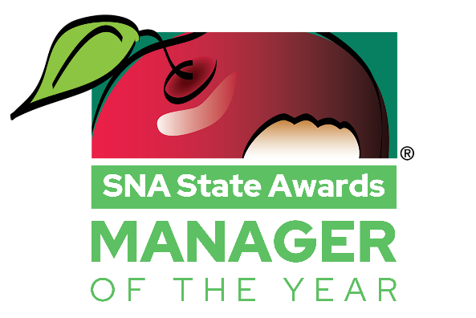

More Memorable SNA Benefits
E-Newsletters
School Nutrition SWAG
SNA Recognizes You!
  Star Club
  SNA Awards
  And more!

Slide 14

Love the Benefits?
Suggest a New Member, Today!
Recruit at least ONE new SNA member during a calendar month between October-May to be eligible for our monthly prize drawing of a $25 gift card. Monthly campaign winners will be showcased on SNA social media platforms.
In addition, there are two chances to enter the Pay It Forward Membership Drawing—in November and May—by nominating a colleague for a free SNA membership and sharing why they belong in our community
Notes:
Membership Recruitment - School Nutrition Association
Our annual membership campaign is an easy, rewarding way for members to stay engaged!
Recruiting at least one member (I.e. being listed as the "referrer" on their membership application) will automatically enter you into the monthly prize drawing – you may also have the opportunity to be featured on SNA's social media with other monthly winners.
Plus, recruiting at least three members gains you access to SNA’s exclusive Star Club, which recognizes their top-recruiters.

Slide 15


Thank You!
https://schoolnutrition.org/about-us
Notes:
Join/Renew - School Nutrition Association
"Thank you so much for joining us today! To begin your application, simply scan this QR code! If you have questions about membership, you can come see me after this session or you can email membership@schoolnutrition.org and one of SNA representatives would be glad to help."

