Slide 1



SNF Equipment Grant
2026

Slide 2


Program Overview
For the 2026 program, LTI is partnering with the School Nutrition Foundation to award one school district with a new Grab ‘N Go Cart of their choosing from eight (8) standard LTI models valued at up to $10,000.
LTI is committed to helping school feeding programs grow and provide school foodservice professionals with the tools they need to help feed millions of school children each year. The LTI Equipment Award Program will provide free equipment to school districts who demonstrate a need based on the current state of existing equipment and its effect on the ability to meet current demand. The equipment award is designed to match equipment with need and help transform and grow a district's feeding program.
LTI believes in giving back to the school nutrition community.

Slide 3
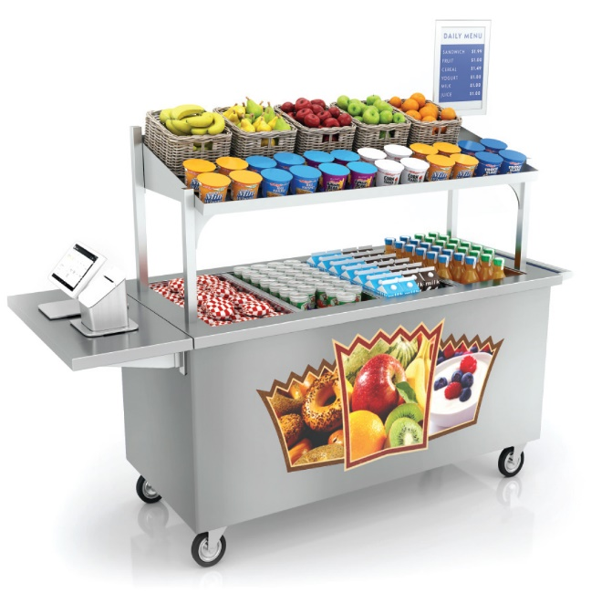
Choose a Grab ‘N Go Cart (valued up to $10,000)

