Slide 1
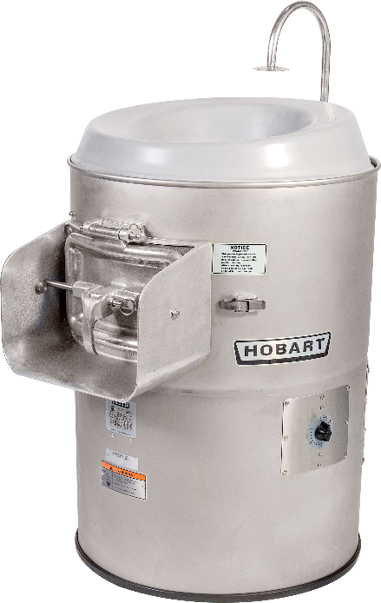
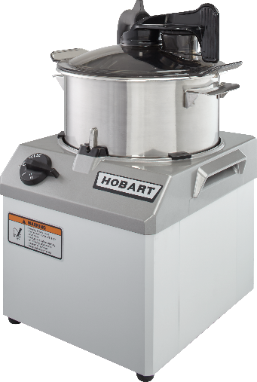
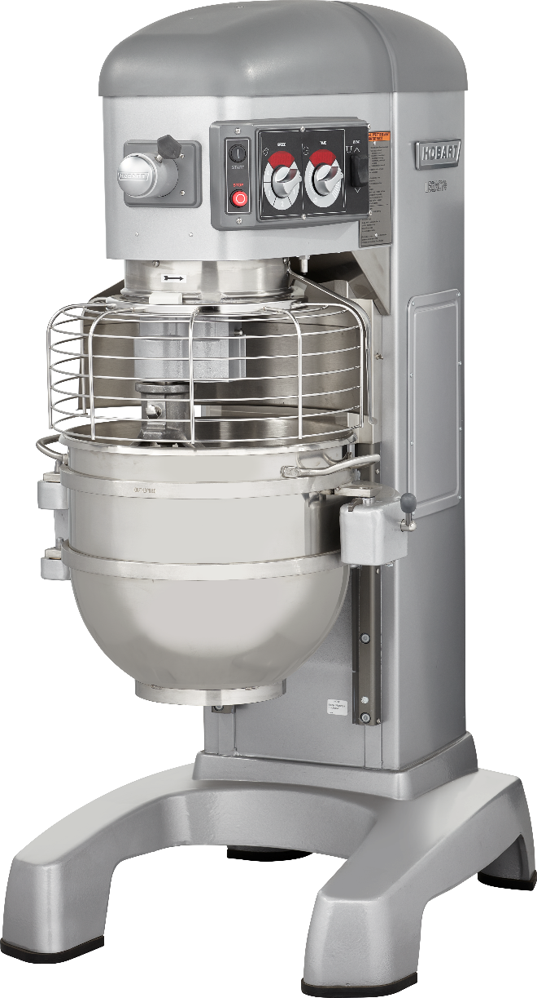
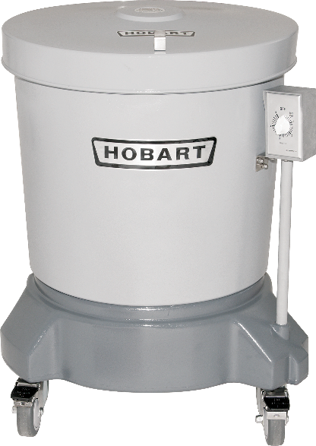
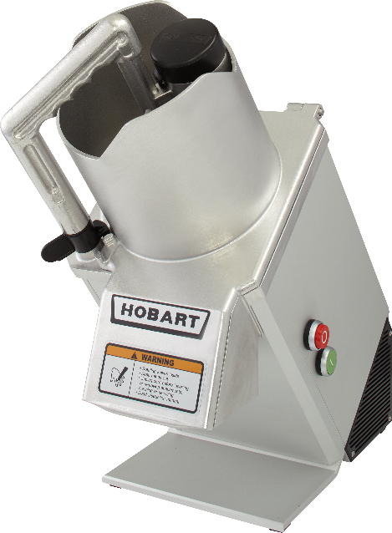
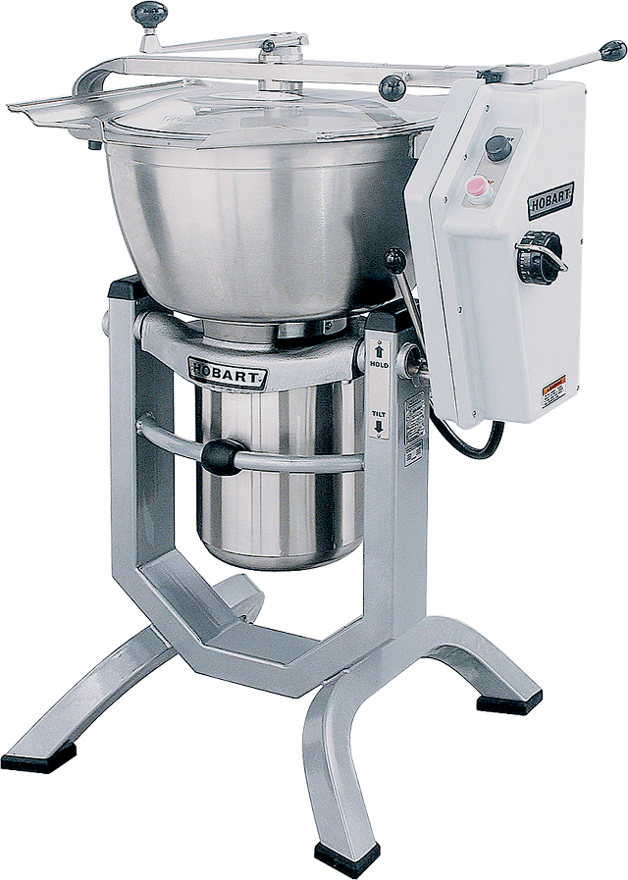
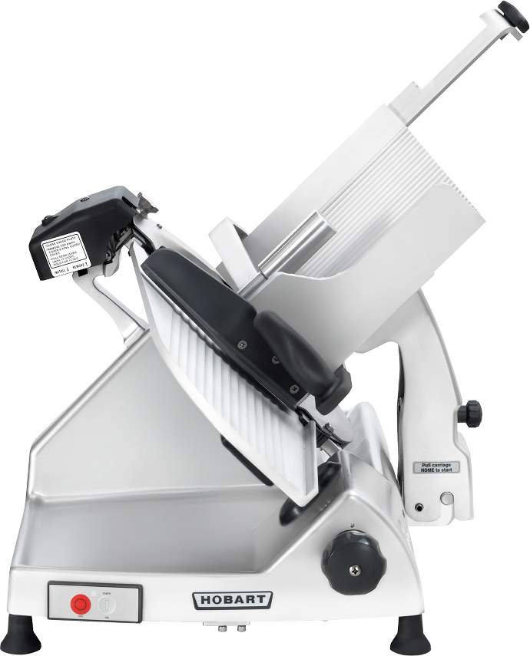
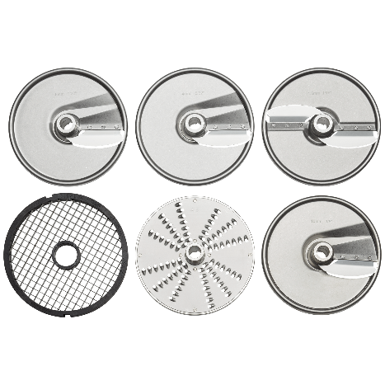
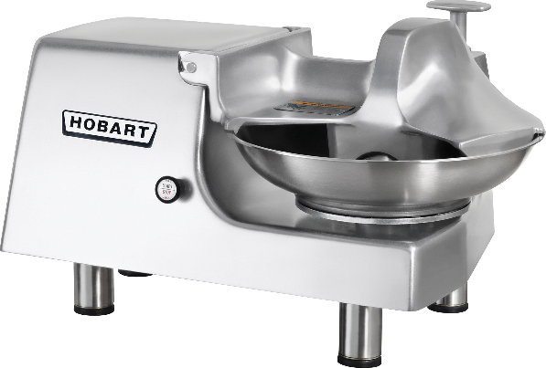
Select food preparation equipment up to $40,000 in value
Hobart will work with the winner to select $40,000 worth of food prep equipment based on their needs. This could include mixers, slicers, food processors, vertical cutter mixers, food cutters, salad spinners, and potato peelers. Equipment can be placed at multiple schools across the district if needed.

Slide 2
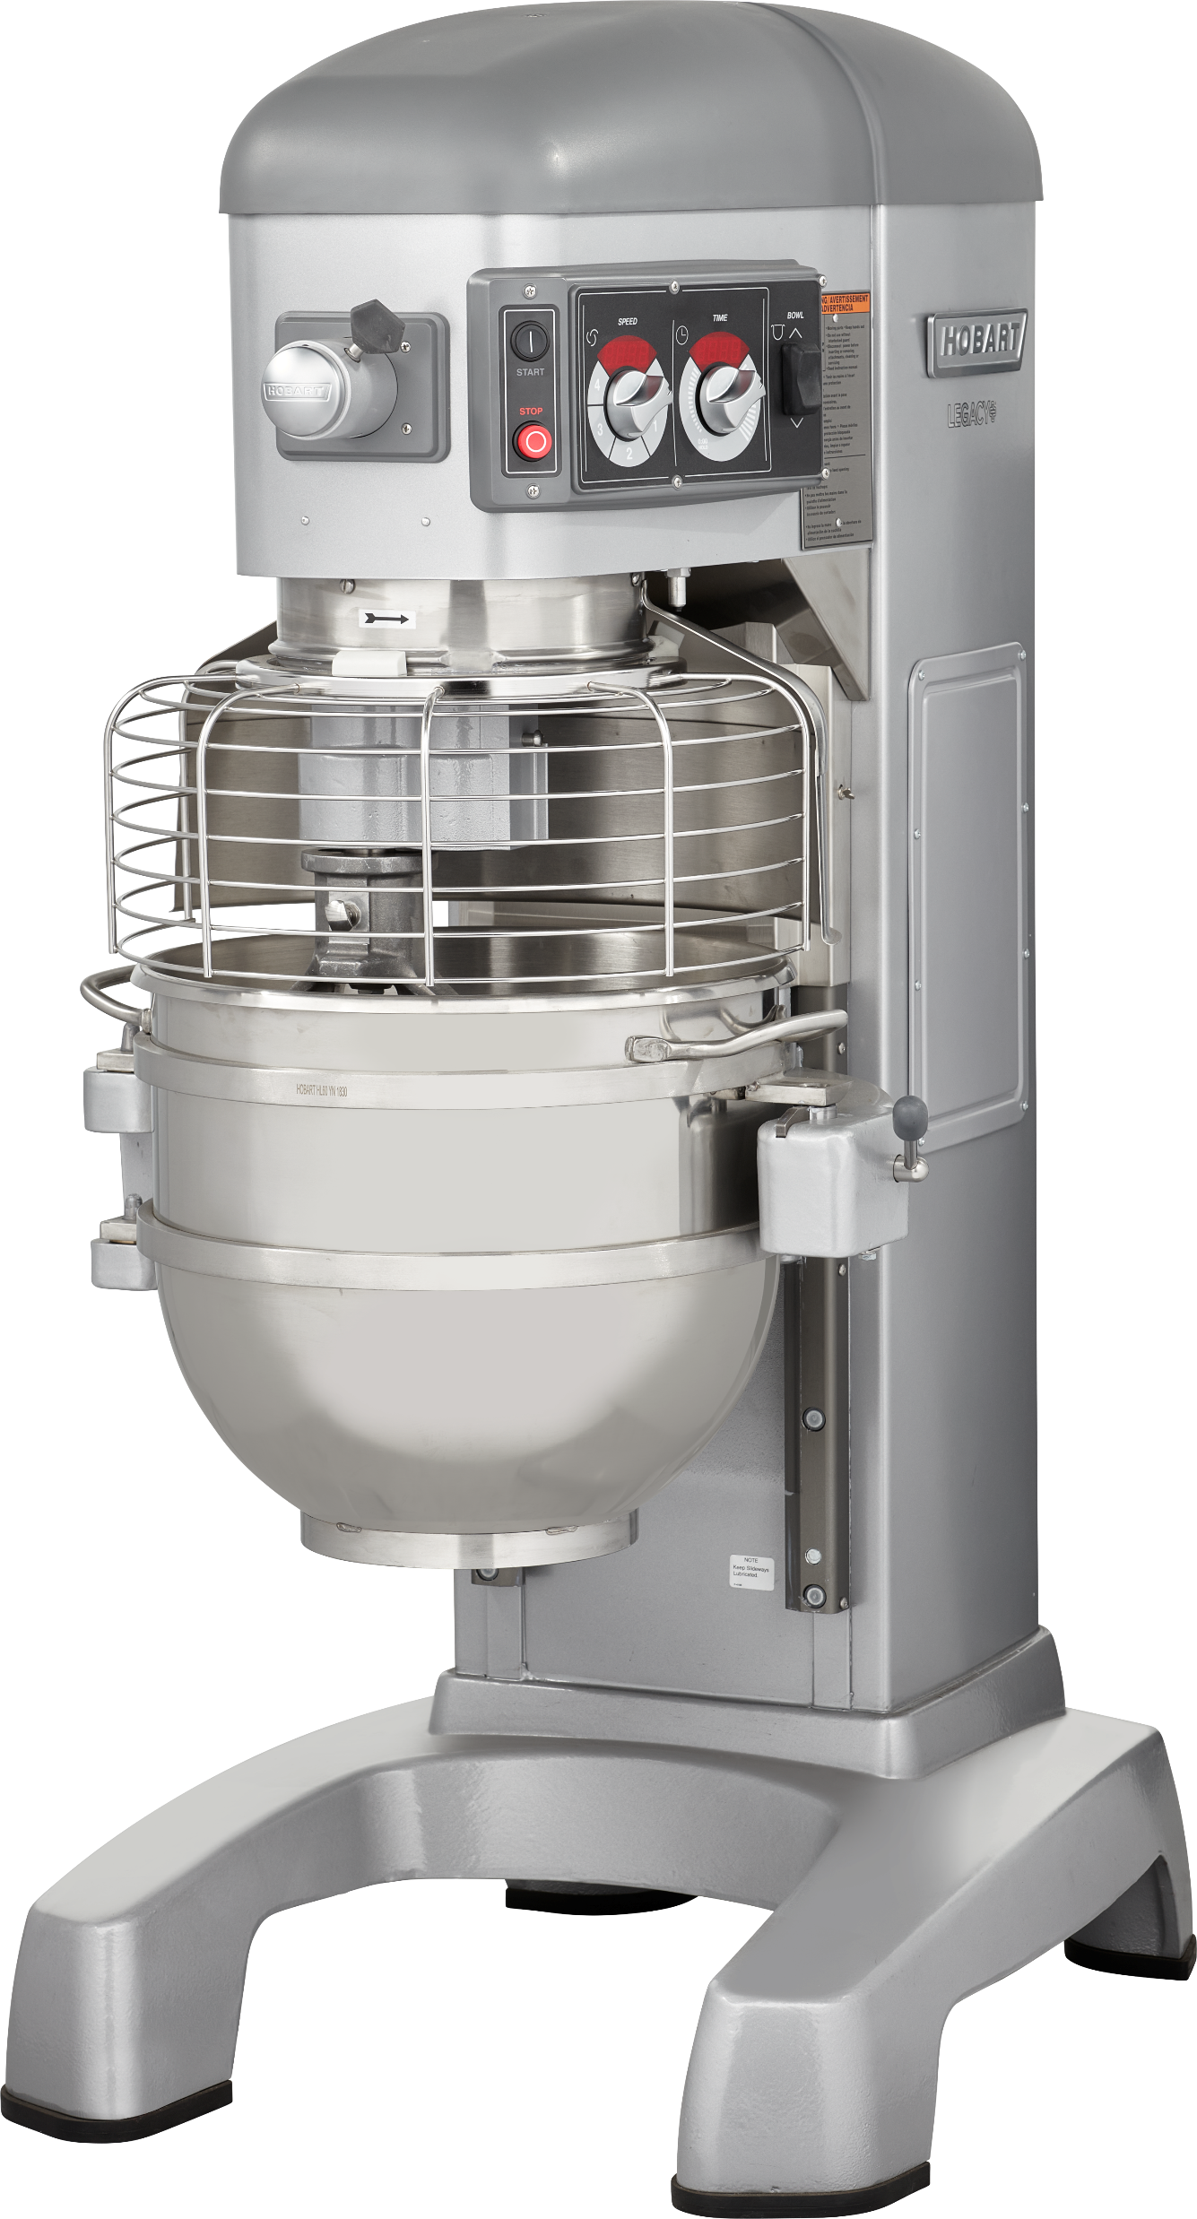
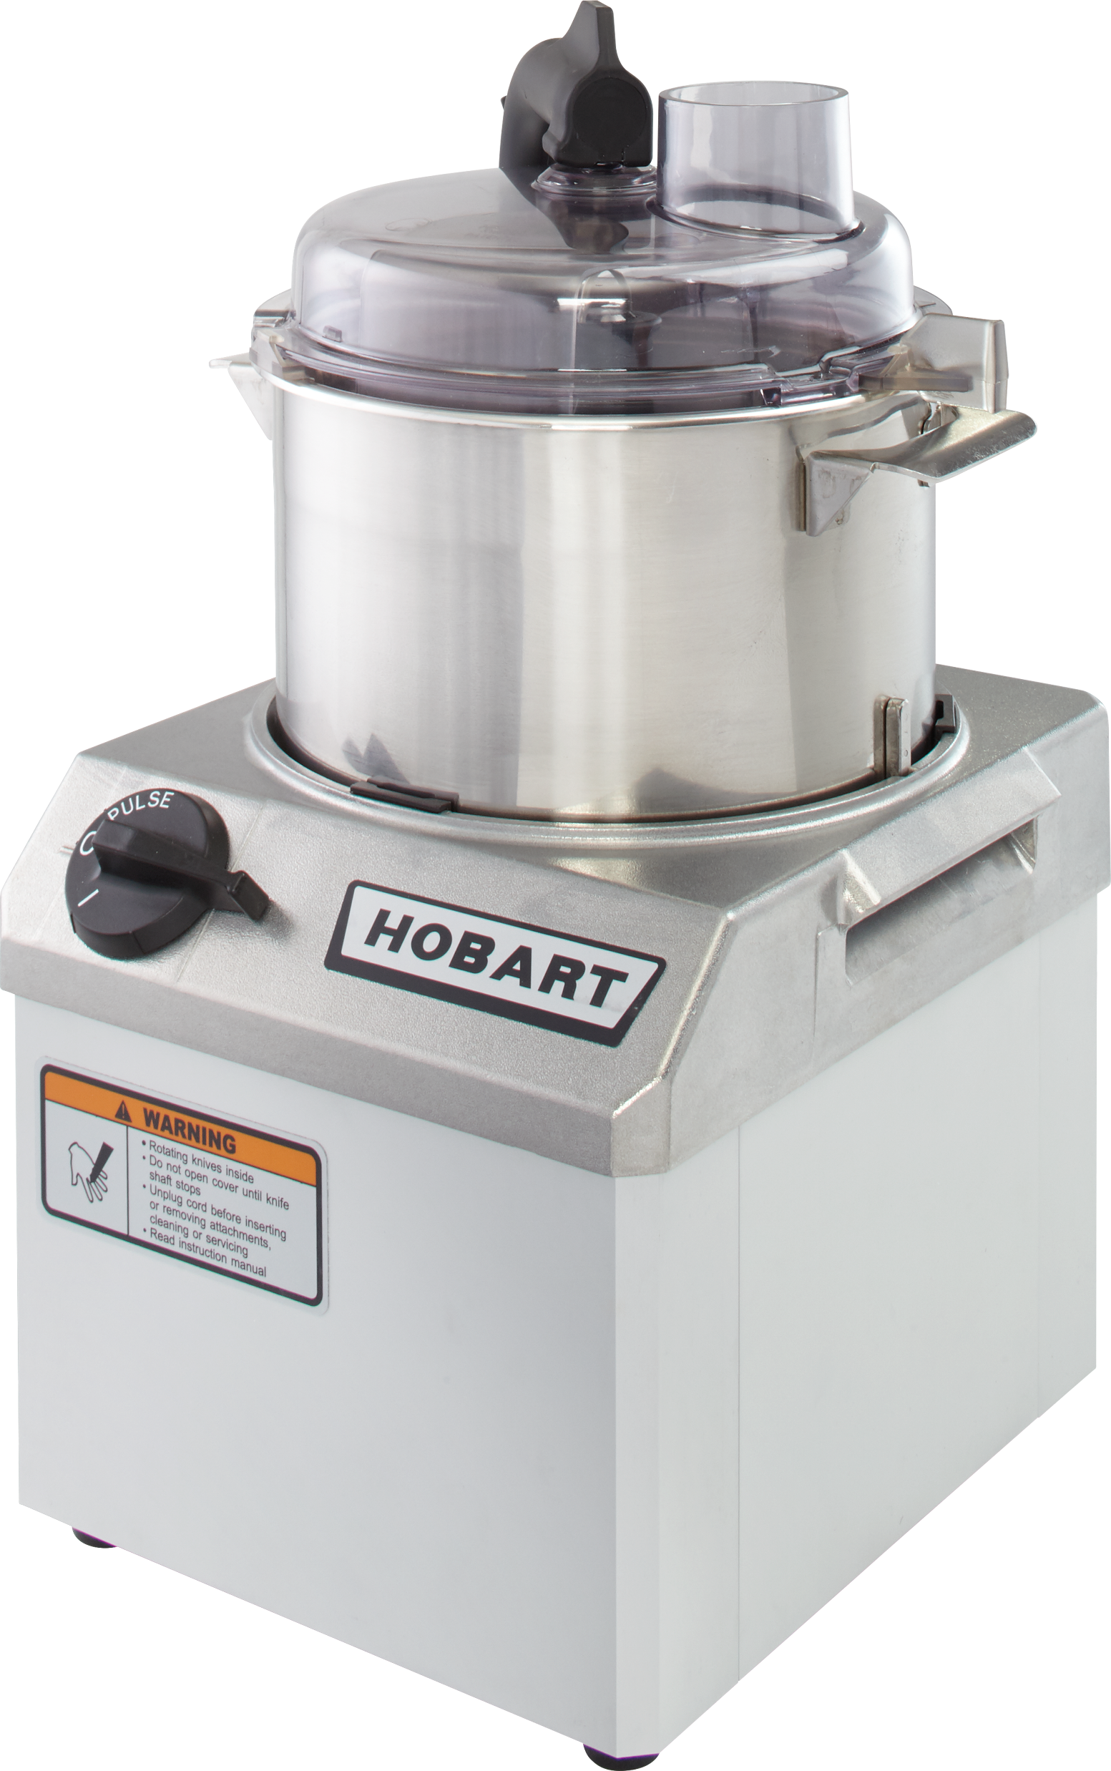
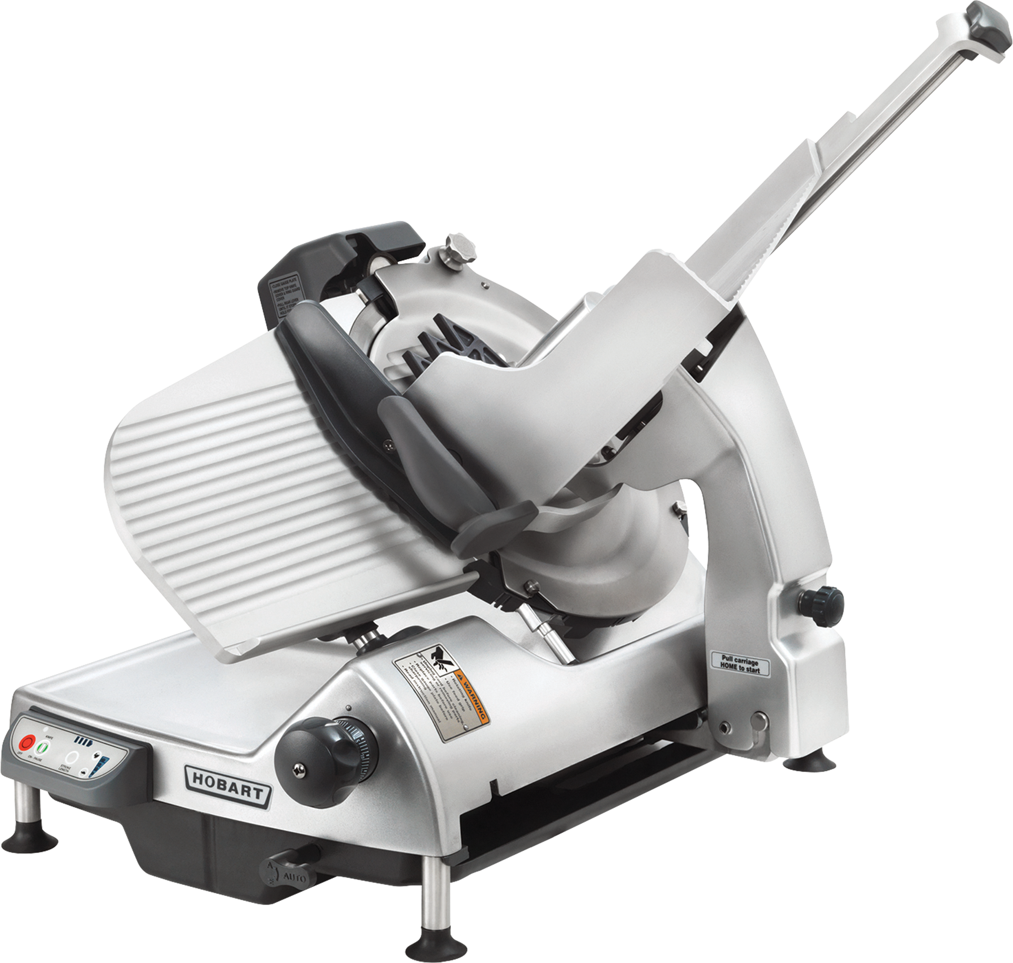
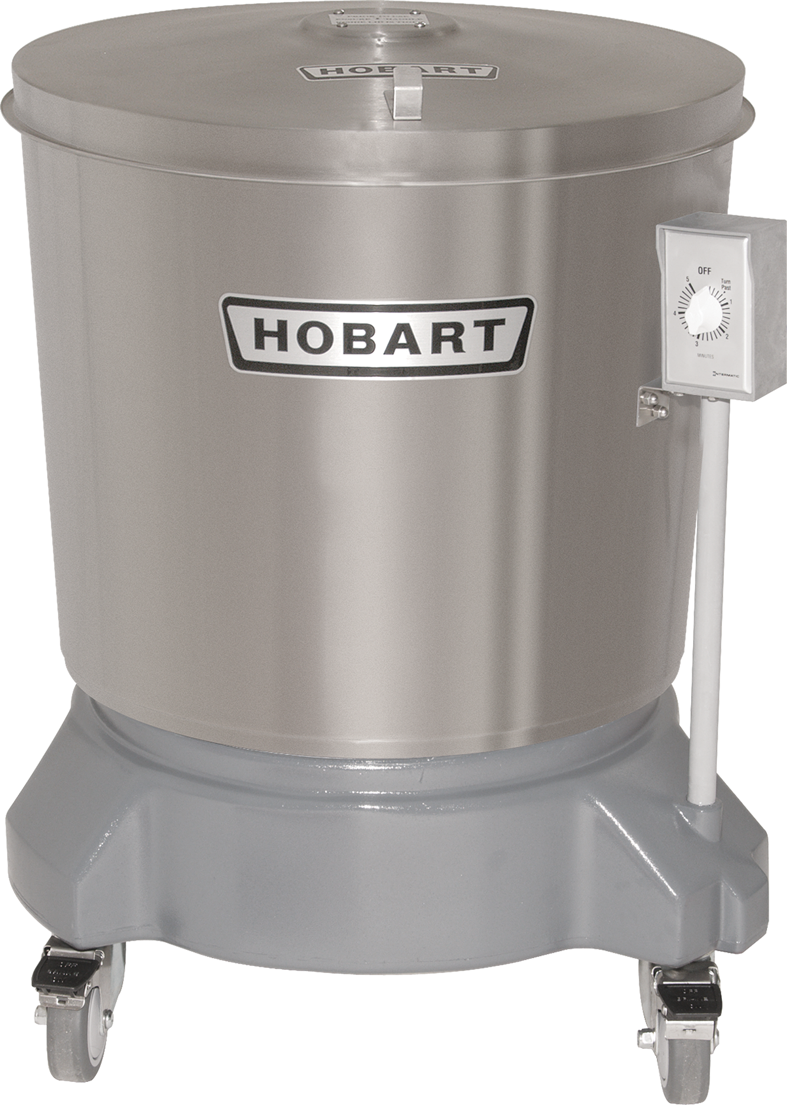
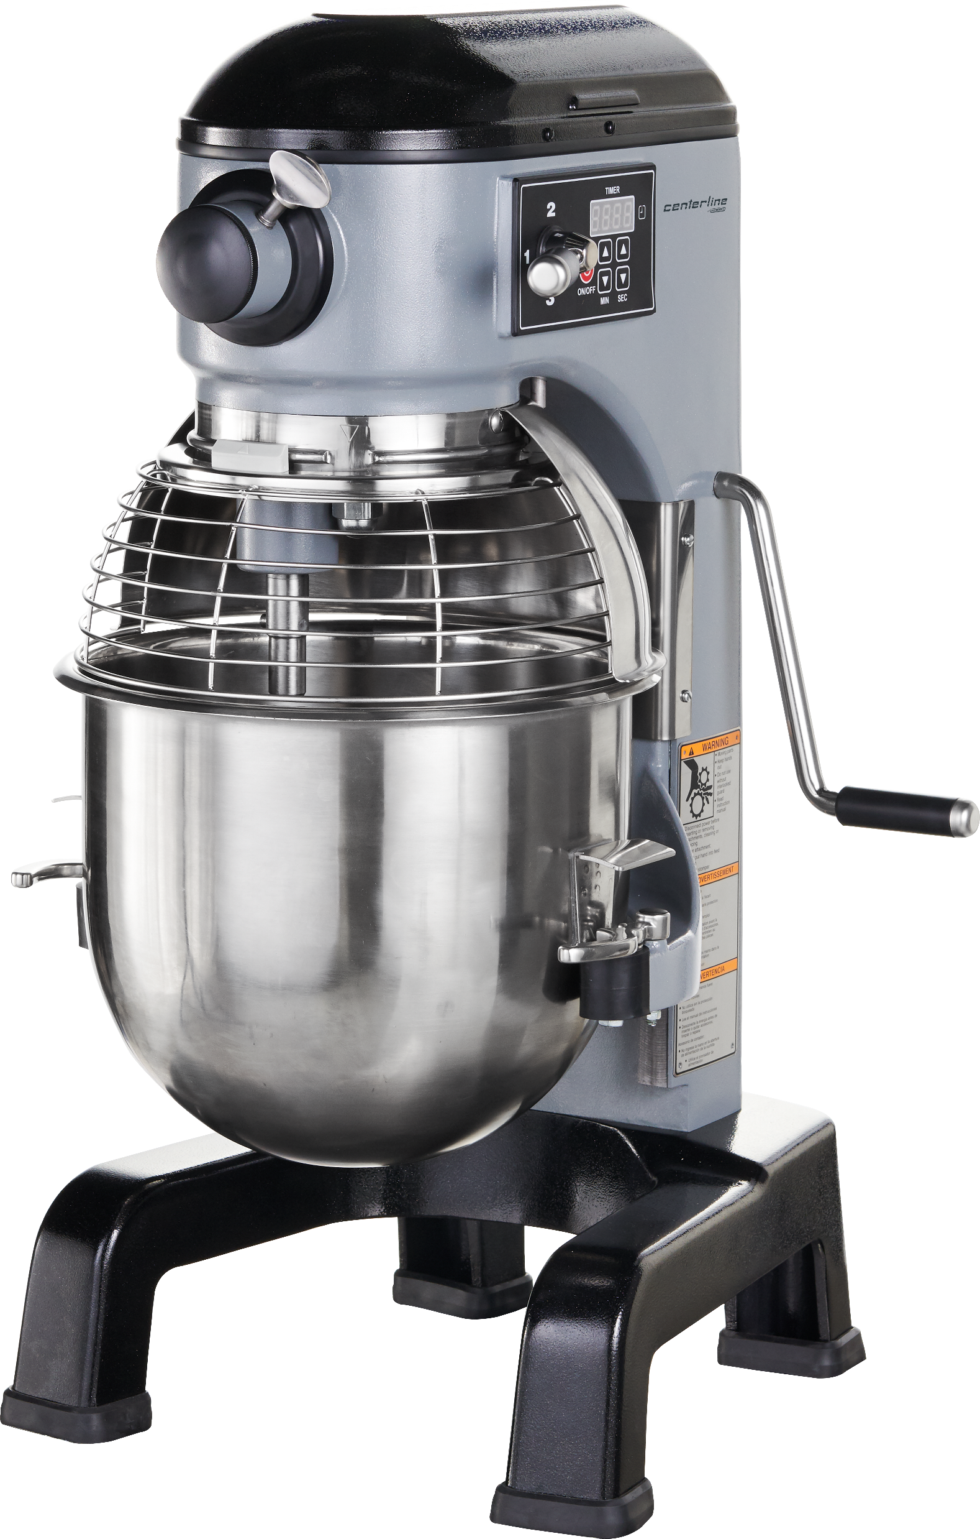
Example equipment combinations
Equipment | Description | Approx. Value
HL600-1STD | 60-quart mixer with bowl, beater, whip, dough hook | $28,492.80
FP41-1 | 4-quart bowl-style food processor | $3,758.30
+
Equipment | Description | Approx. Value
FP150-1A | Full hopper continuous-feed food processor, 3 cutting tools | $7,051.10
HS9-1 | Automatic slicer with interlocks | $13,063.40
HMM20-1STD | Centerline by Hobart 20-quart mixer with bowl, beater, whip, dough hook | $4,214
SDPS | Stainless steel salad dryer | $5,035.80
+
+
+

Slide 3
Conditions
Grantee will need to make the choice of equipment and verify utilities.
Grantee will be responsible for receiving equipment, uncrating and checking for damage, “set-in-place” and final connections.
FEG will ship to school district or their agent “prepaid and allow.”

